Slide 1


Lab 2
Eman Raslan

Slide 2
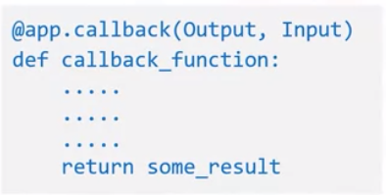
Dash - Callbacks
Callback function is a python function that are automatically called by Dash whenever an input components' property changes.
Decorator
@app.callback

Slide 3
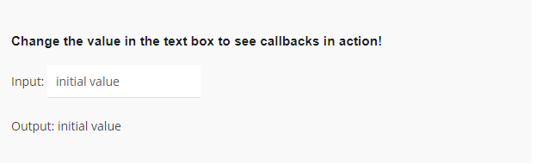
Dash – Callbacks: Example 1

Slide 4
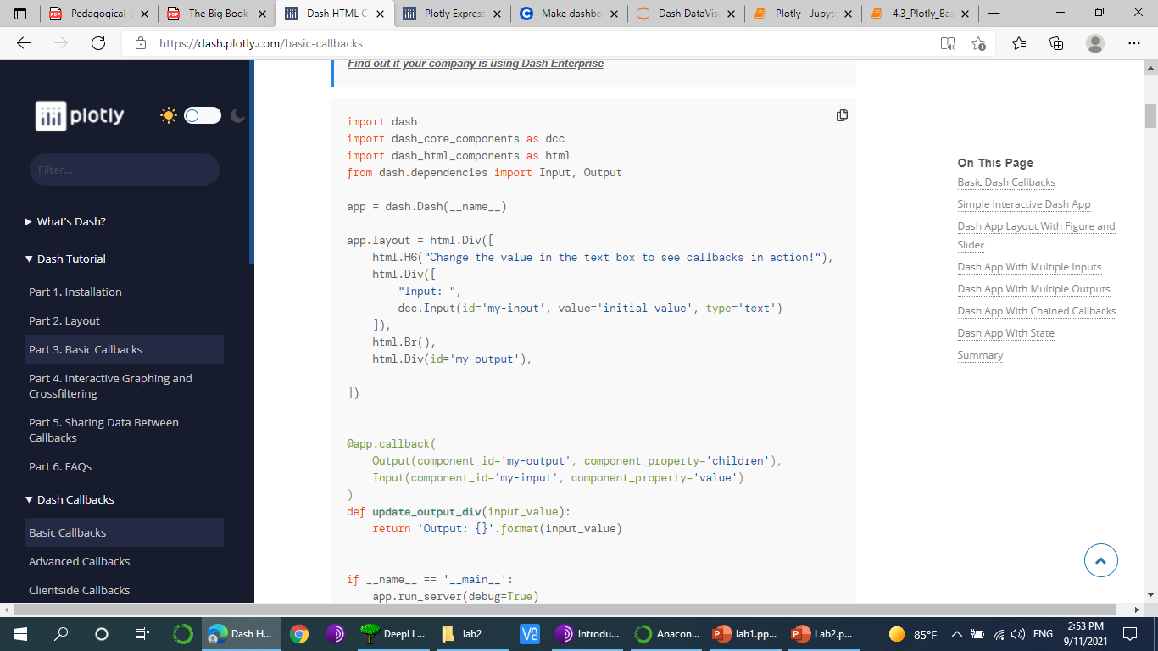

Slide 5
Dash – Callbacks: Example 1
In Dash, the inputs and outputs of our application are simply the properties of a particular component. In this example, our input is the "value" property of the component that has the ID "my-input". Our output is the "children" property of the component with the ID "my-output".
Whenever an input property changes, the function that the callback decorator wraps will get called automatically. Dash provides the function with the new value of the input property as an input argument and Dash updates the property of the output component with whatever was returned by the function.
The component_id and component_property keywords are optional (there are only two arguments for each of those objects). They are included in this example for clarity but will be omitted in the rest of the documentation for the sake of brevity and readability.
Don't confuse the dash.dependencies.Input object and the dcc.Input object. The former is just used in these callback definitions and the latter is an actual component.
Notice how we don't set a value for the children property of the my-output component in the layout. When the Dash app starts, it automatically calls all of the callbacks with the initial values of the input components in order to populate the initial state of the output components. In this example, if you specified something like html.Div(id='my-output', children='Hello world'), it would get overwritten when the app starts.

Slide 6
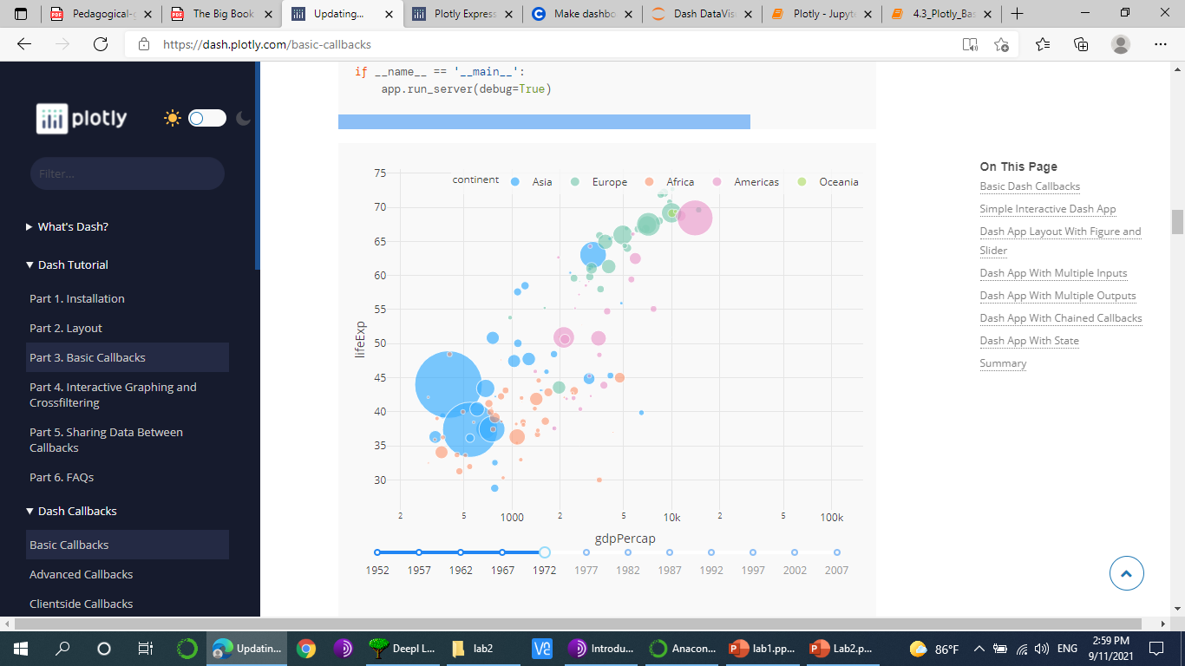
Dash – Callbacks: Example 2

Slide 7
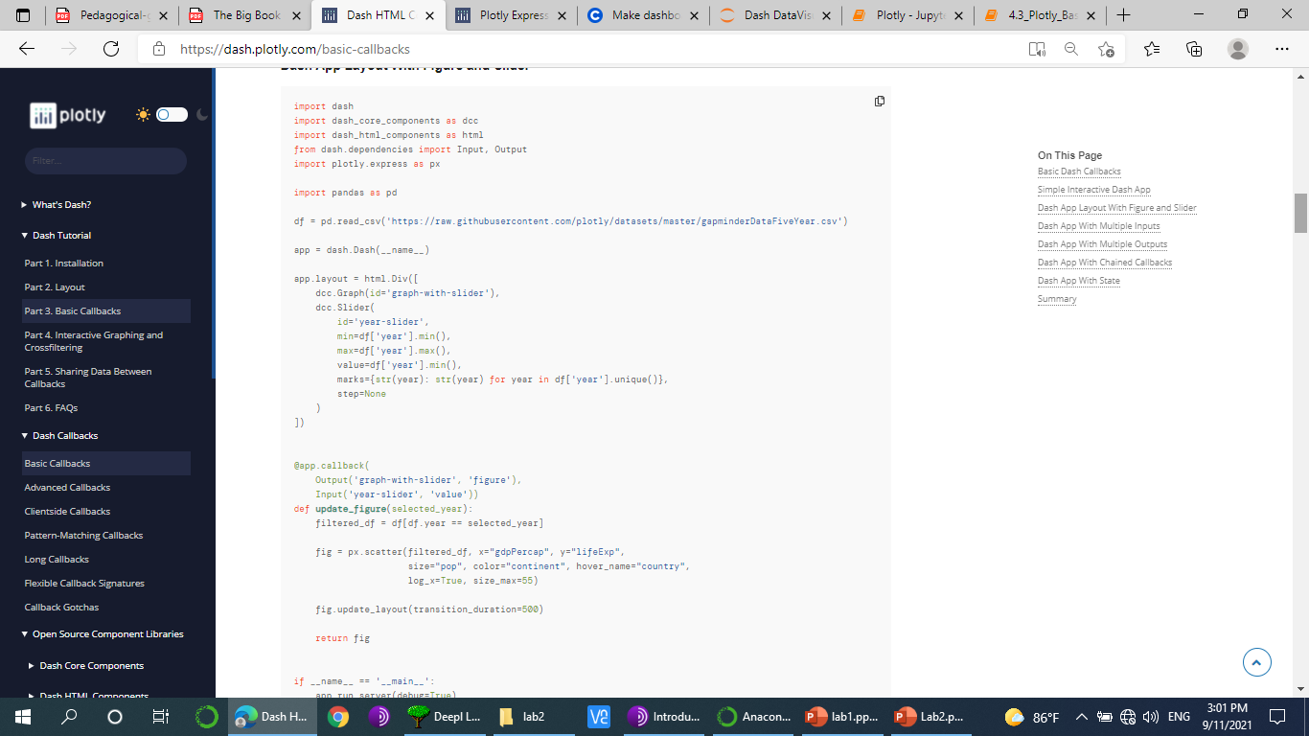

Slide 8
Multiple Inputs

Slide 9
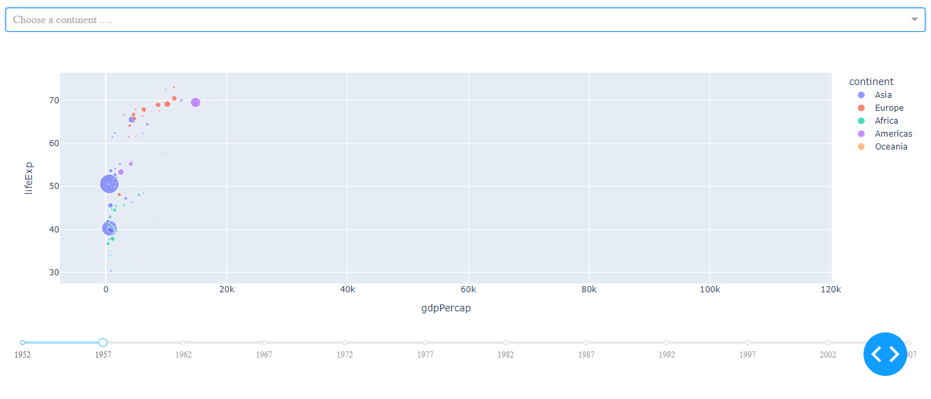
Dash – Callbacks: Example 3

Slide 10
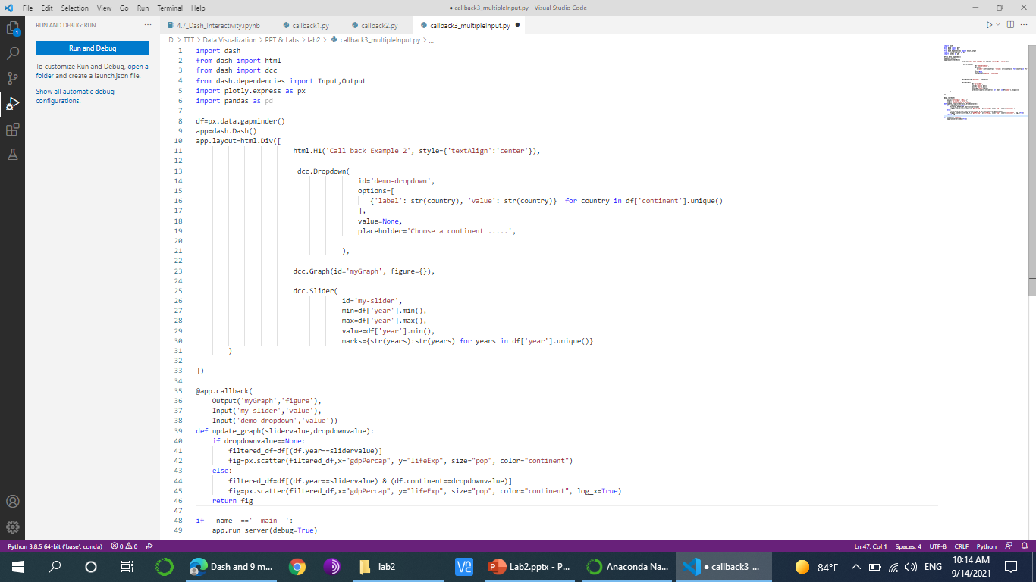

Slide 11
Multiple Outputs

Slide 12
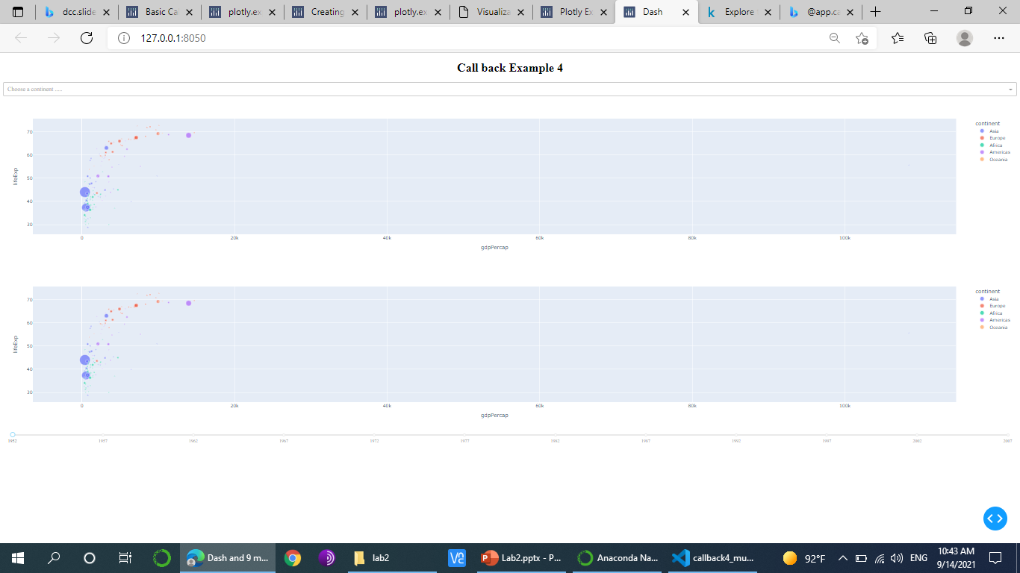
Dash – Callbacks: Example 4

Slide 13
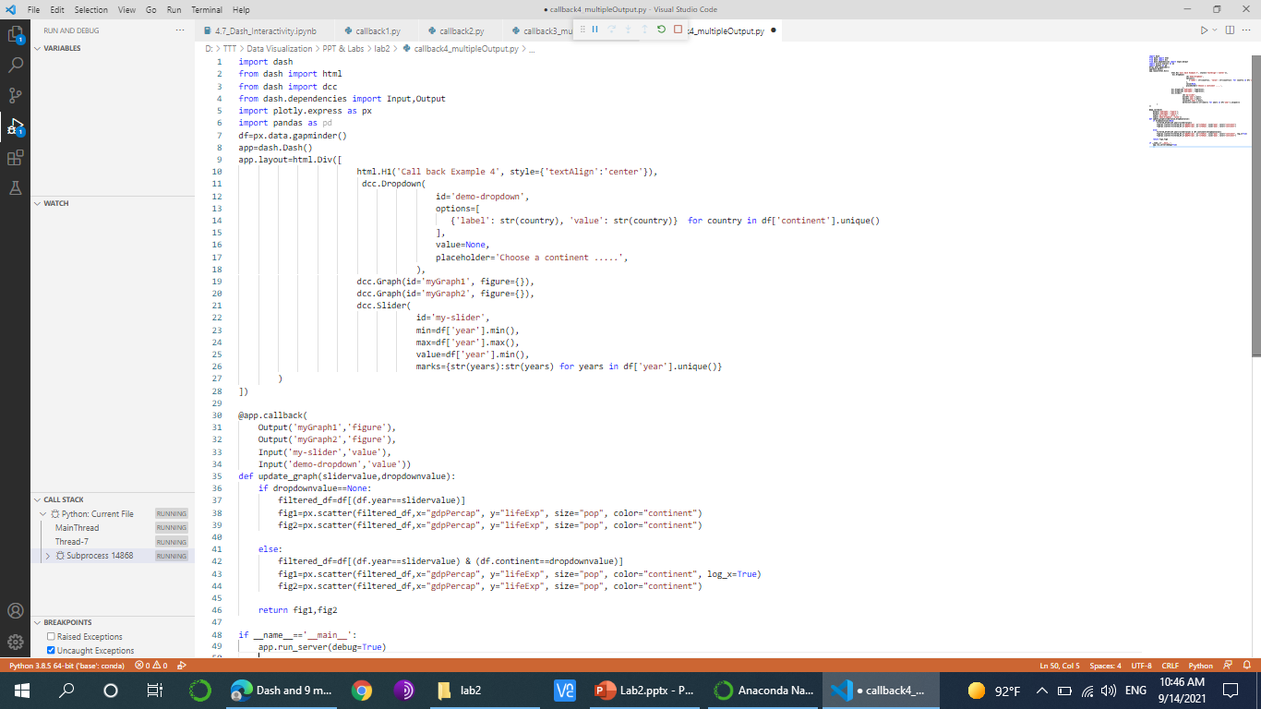

Slide 14
Controlling Callbacks with Dash State

Slide 15
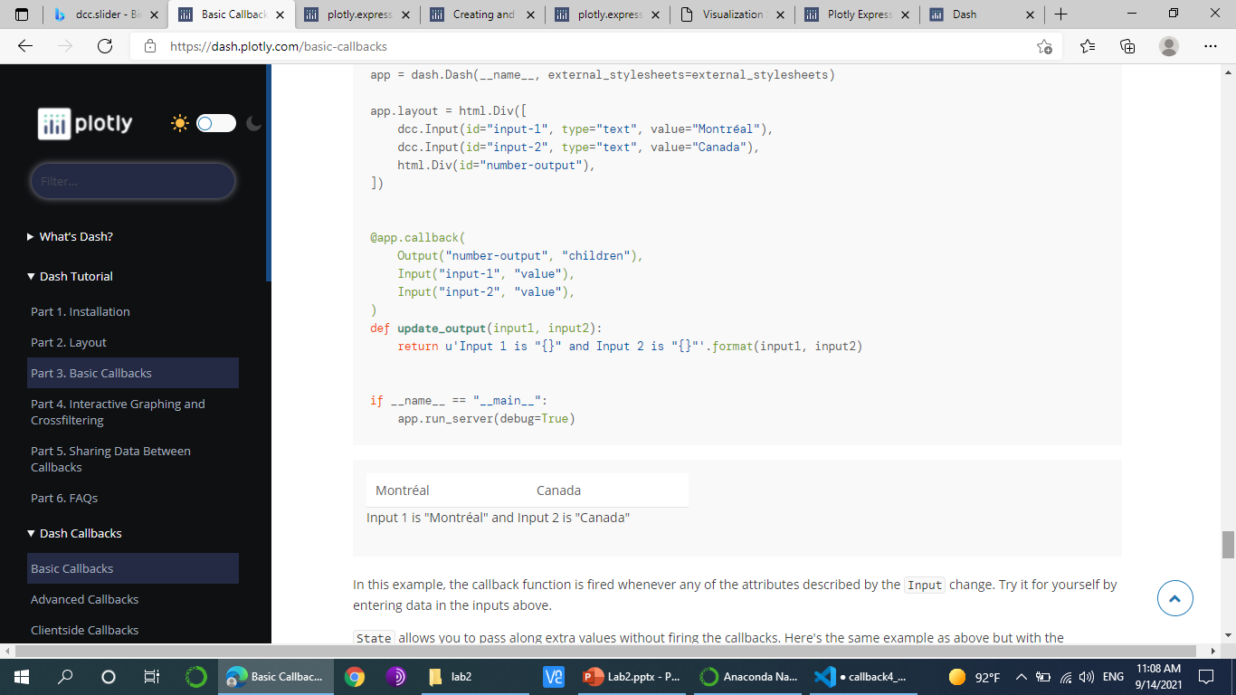
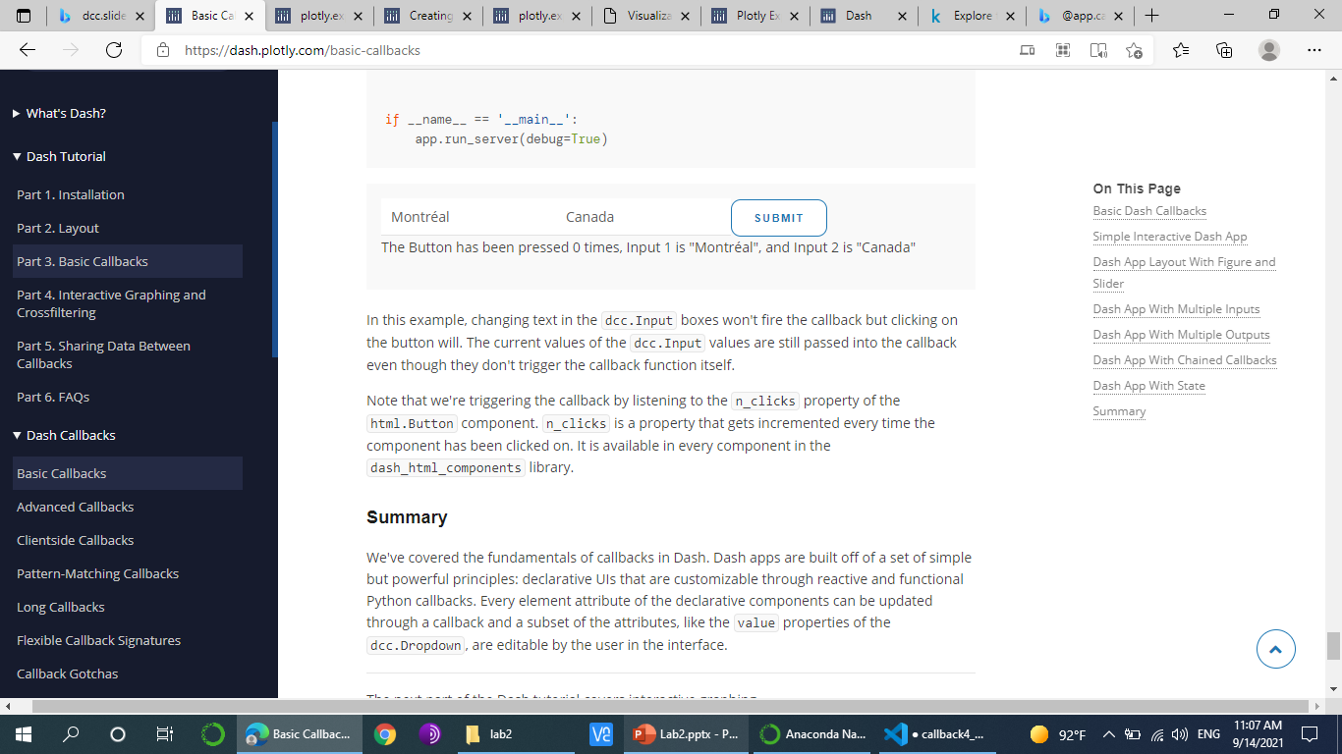
Controlling Callbacks with Dash State
In the previous interactive examples we’ve seen how inputs immediately affect outputs. As soon as values are entered, the page updates to reflect any changes.
What if we wanted to wait before displaying the page? What if we wanted time to enter a series of changes before submitting them? This is where dash.dependencies.State comes in. Dash offers the ability to store saved changes, and send them back on command.

Slide 16
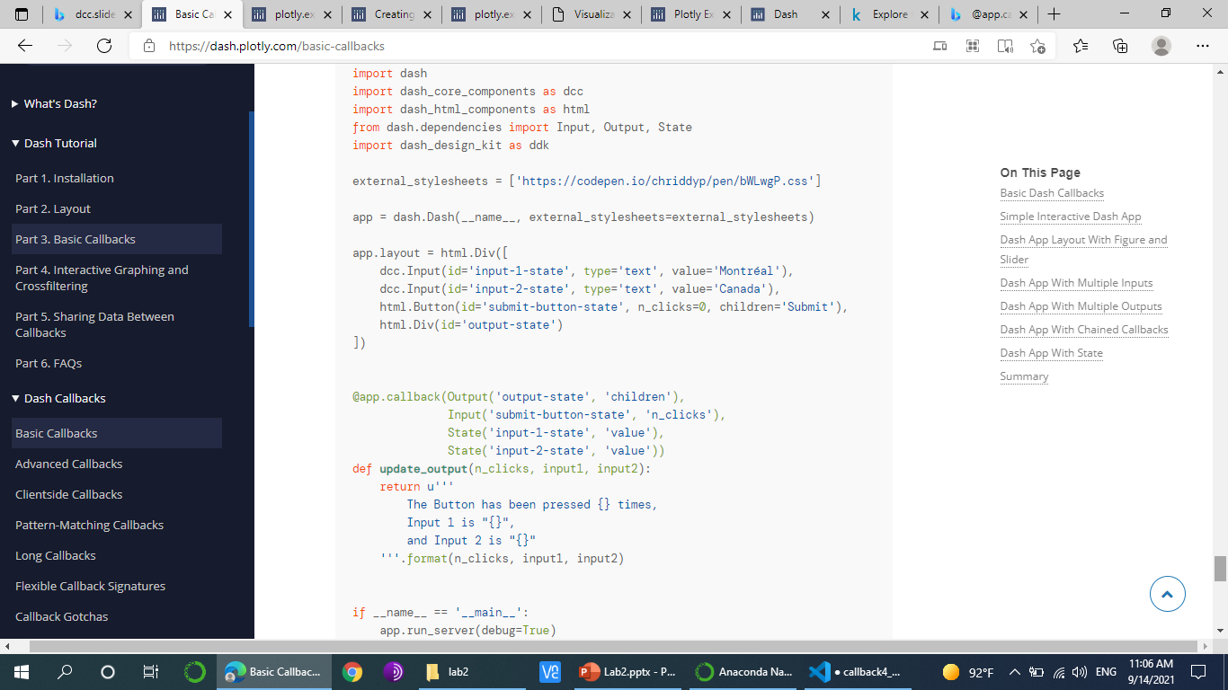
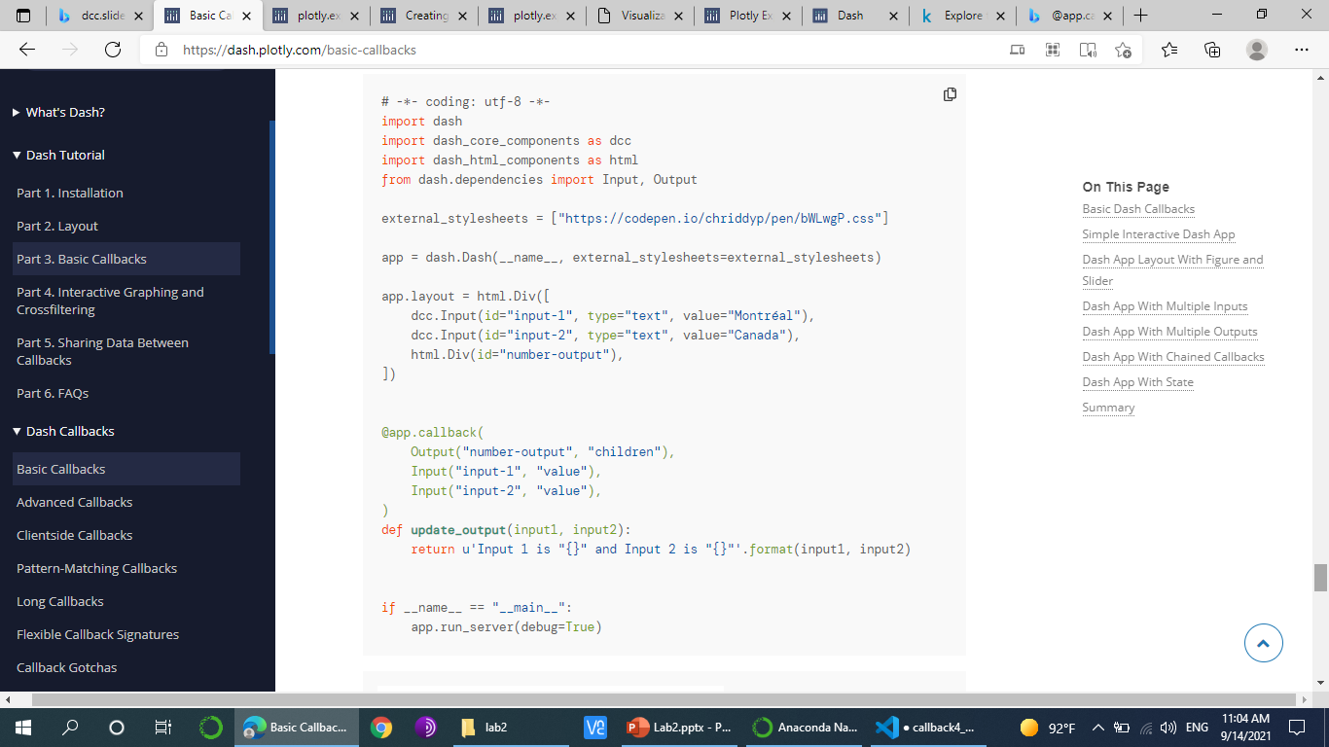
Dash – Callbacks: Example 5

Slide 17
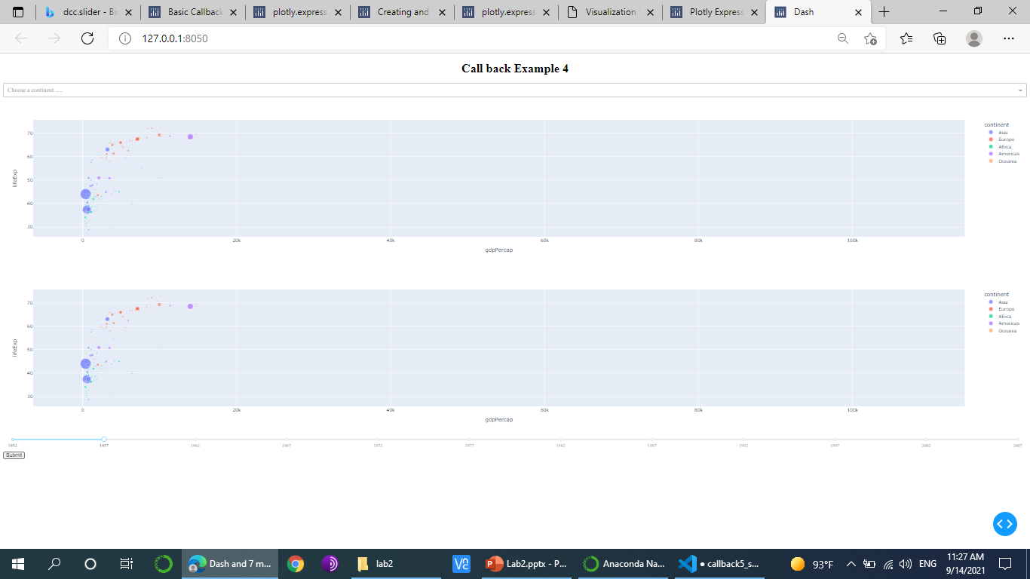

Slide 18
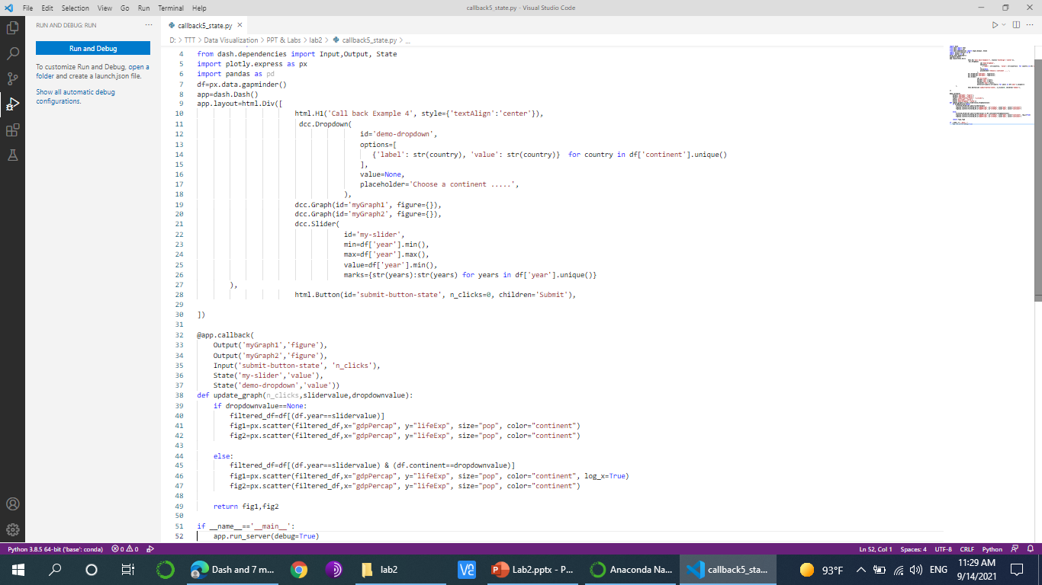

Slide 19
Dash App With Chained Callbacks
Notes:
You can also chain outputs and inputs together: the output of one callback function could be the input of another callback function.

Slide 20


Slide 21
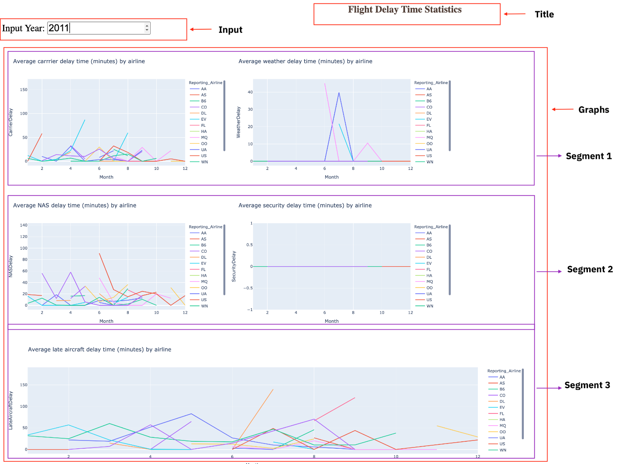
Flight Delay Time Statistics

Slide 22
Lab summary
The first lab covered the layout of Dash apps:
The layout of a Dash app describes what the app looks like. It is a hierarchical tree of components.
The dash_html_components library provides classes for all of the HTML tags and the keyword arguments describe the HTML attributes like style, className, and id.
The dash_core_components library generates higher-level components like controls and graphs.
The second lab covered callbacks:
A callback function is a python function that is automatically called by Dash whenever an input component's property changes. Callback function is decorated with @app.callback decorator.
Callback decorator function takes two parameters: Input and Output. Input and Output to the callback function will have component id and component property.
The dash.dependencies.Input and dash.dependencies.Output components constantly monitor the page, and update an output display, graph, or other page content as needed.
Dash supports multiple inputs and multiple outputs.
You can hold onto input data using dash.dependencies.State, and have it submitted on demand using a Button or other html element.

Slide 23

Thank You

